Slide 1
Defining Non-Traditional Students
Wendy Lin
Norma Fewell
Steven Graunke
IUPUI Office of Institutional Research and Decision Support
INDIANA UNIVERSITY–PURDUE UNIVERSITY INDIANAPOLIS

Slide 2
What we plan to do…
Retention literature – how have non-traditional students been defined in the past?
How we looked at non-traditional students at IUPUI
Study Results
Implications and discussion

Slide 3

What does “non-traditional” mean to you?

Slide 4
Defining Non-traditional in retention studies

Slide 5

Why should we care?
Lumina Goal 2025
60% of Americans with “high quality” credentials
Changing economy
Understanding students

Slide 6
Why should we care?
SECTION TITLE GOES HERE IF NECESSARY
Nationally (Lumina Foundation, 2017)
40% of CC students working 20 or more hours per week
40% attending part-time
38% of undergraduates are 25 years of age or older

Slide 7
Why should we care?
SECTION TITLE GOES HERE IF NECESSARY
IUPUI Indianapolis – Fall 2016 beginners
11% of students plan to work 20 or more hours per week off campus
4% attending part-time
0.5% (17 out of 3,761) are 25 years of age or older

Slide 8
Why should we care?
SECTION TITLE GOES HERE IF NECESSARY
IUPUI Indianapolis – Fall 2016 transfers
41% of students plan to work 20 or more hours per week off campus
18% attending part-time
23% are 25 years of age or older

Slide 9

How did we used to think about nontraditional students?
Summerskill (1962)
“personal or financial or other reasons” cause withdrawal (p.631)
Astin (1975)
Nontraditional = “married, older or attending part-time” (p.167)
Pantagges and Creedon (1978)
Age doesn’t matter when finances, motivation, and other factors are included
Photo courtesy of IUPUI Special Collections Archive

Slide 10

Metzner and Bean studies
(Bean & Metzner, 1985; Metzner & Bean, 1987)
Student development literature (mostly Chickering, 1969) not appropriate for conceptualizing non-traditional students
One of the following:
25 years or older
Attending part-time
Living off-campus
Findings
Intent to persist, work hours, number of hours enrolled have stronger effect than social integration
“It is very difficult to create an institutional identity and increase a student’s psychological attachment to an institution where traditional social integration variables seem to have little effect on student behavior.” (Bean and Metzner, 1987, p. 34)
Photo courtesy of IUPUI Special Collections Archive

Slide 11
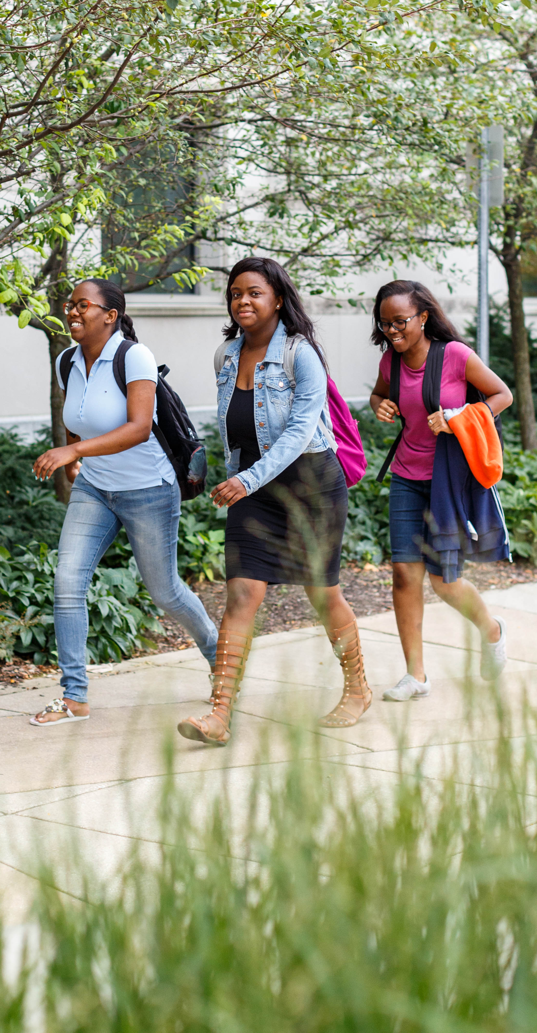
How have we thought about nontraditional students more recently?
Arbona and Nora (2007)
Delayed enrollment at least six months
NCES (2017)
Most other retention studies use age (24 and older)
Adelman (2006)
Nontraditional = enrolled in college for the first time after 20.
Proxy for other factors (work, family responsibilities, etc.)
This is not the definition NCES uses for retention analyses!
Enrollment projections use 24 years of age

Slide 12
The definition NCES uses for retention
Horn and Carroll (1996)
“Choices and behavior that may increase students’ risk of attrition” (p. 6)
Intervention is [sometimes] possible
Support to overcome obstacles
Encouragement
One point for each characteristic
Level of Nontraditional
Captures students with “non-traditional “ issues who aren’t “non-traditional” age

Slide 13
The definition NCES uses for retention
Horn and Carroll (1996)
  Enrollment patterns
    Delayed enrollment by a year or more
    Attending part-time
  Financial and Family Status
    Having a dependent (other than a spouse)
    Being a single parent
    Working full-time
    Being financially independent
  High School Graduation Status
    Earning a GED rather than a high school diploma

Slide 14
How is IUPUI defining non-traditional?
Use national literature to define nontraditional
NCES characteristics are age-neutral
Currently tracking both 23 and 25
Which is better?
National would be 25 or older

Slide 15
Our Research Questions…
Does score on the Horn and Carroll scale have a significant effect on retention net the effect of age and other academic and financial variables?
Could enhanced understanding of the Horn and Carroll model lead to an expanded understanding of the challenges faced by nontraditional students as they complete their degree at IUPUI?

Slide 16
Methodology

Slide 17
Methodology
Survey of incoming first-year and transfer students in Fall 2015
“How many hours per week” – working on campus, working off campus.
Merged with IUPUI data
Enrollment status (full-time or part-time)
FAFSA data
Earned a GED
Construct Horn & Carrol scale!

Slide 18
Methodology
Additional data
High school GPA
First generation
Transfer hours
Unmet financial need (CDS definition)
Received Pell grant
Age

Slide 19
Analysis
Descriptive statistics
Correlation
Logistic regression

Slide 20
Descriptive statistics
(Non-traditional Characteristics) *
Characteristic | Total | N | Percentage
Attending part-time | 4,845 | 422 | 8.7%
GED | 4,845 | 1 | <0.1%
Not claimed as a dependent | 4,268 | 531 | 12.4%
Has a child | 4,279 | 180 | 4.2%
Single parent | 4,279 | 89 | 2.1%
Working full-time ** | 338 | 24 | 7.1%
* Full sample, including traditional and non-traditional students. Average age = 19.7, std. dev = 4.0
** Obtained from Student-Institution fit survey. All other data from University records

Slide 21
Correlation with age
Characteristic | Total | N | r
Attending part-time | 4,845 | 422 | 0.29
GED | 4,845 | 1 | 0.08
Not claimed as a dependent | 4,268 | 531 | 0.69
Has a child | 4,279 | 180 | 0.50
Single parent | 4,279 | 89 | 0.20
Working full-time | 338 | 24 | 0.32
All correlations statistically significant at α < 0.01

Slide 22
Descriptive statistics
(Race/Ethnicity)
Race/Ethnicity | Percent of Minimally Nontraditional* | Percent of Traditional
Native American/Alaska Native | 0.2% | 0.1%
Asian | 3.2% | 3.7%
African American | 18.2% | 8.7%
Latino/a | 6.7% | 8.2%
International | 1.2% | 0.6%
Native Hawaiian/Pacific Islander | 0.6% | 0.1%
Two or More Races | 5.8% | 5.5%
White | 63.5% | 72.8%
Unknown | 0.7% | 0.3%
* At least one nontraditional characteristic (Attending part-time, GED, Not claimed as a dependent, Has a child, Single parent). Working full-time excluded due to low response rate.

Slide 23
Descriptive statistics
(Other Characteristics)
Characteristic | Percent of Minimally Nontraditional * | Percent of Traditional
Female | 54.0% | 60.2%
Transfer | 70.2% | 14.6%
First Generation | 40.8% | 34.6%
Receiving a Pell Grant | 64.5% | 42.6%
* At least one nontraditional characteristic (Attending part-time, GED, Not claimed as a dependent, Has a child, Single parent). Working full-time excluded due to low response rate.
All differences statistically significant at α < 0.01.

Slide 24
Descriptive statistics
(Other Characteristics)
Characteristic | Mean among Minimally Nontraditional * | Mean among Traditional
High School GPA**^ | 3.09 | 3.40
Transfer GPA*** | 2.97 | 2.96
Unmet Financial Need^ | $8,328 | $4,028
* At least one nontraditional characteristic (Attending part-time, GED, Not claimed as a dependent, Has a child, Single parent). Working full-time excluded due to low response rate.
** Among students who entered IUPUI as first-time beginners.
***Among students who entered IUPUI as internal or external transfer students
^ Differences statistically significant at α < 0.01

Slide 25
Logistic Regression:
Fall-Fall Retention
Z transformation of high school GPA and transfer GPA
Same scale
“How much higher was past performance than a person of the same admit type?”
First Generation (1,0)
Unmet need (divided by $1,000)
Easier to interpret results
Received a Pell grant (1,0)
Ethnicity
Exclude null and International
Reference group = White

Slide 26

Logistic Regression:
Fall-Fall Retention
Age: 2 models
No work = More cases
Interaction between Nontraditional scale and age
23 or older =1
25 or older = 1
[Modified] Horn & Carroll scale

Slide 27
Fall-Fall Retention 25 or older
Variable | B | Standard Error | Odds Ratio
Intercept | 1.63 | 0.23
Ethnicity
Native American/Alaska Native | -0.15 | 1.06 | 1.29
Asian | 0.48 | 0.30 | 2.43
African American* | -0.50 | 0.24 | 0.91
Latino/a | -0.16 | 0.25 | 1.29
International | 0.36 | 0.82 | 2.15
Native Hawaiian/Pacific Islander | 0.32 | 0.98 | 2.07
Two or More Races* | -0.56 | 0.26 | 0.86
Unknown | 0.62 | 0.64 | 2.79
Z-score of pre-entry GPA* | 0.60 | 0.04 | 1.82
First Generation* | -0.20 | 0.08 | 0.82
Unmet Need/$1,000* | -0.09 | 0.01 | 0.92
Received a Pell grant | 0.09 | 0.08 | 1.09
Age 25 or older* | 0.33 | 0.15 | 1.40
* Effect is statistically significant net the effect of other variables at α < 0.05

Slide 28
Fall-Fall Retention 23 or older
Variable | B | Standard Error | Odds Ratio
Intercept | 1.62 | 0.23
Ethnicity
Native American/Alaska Native | -0.12 | 1.06 | 1.32
Asian | 0.49 | 0.30 | 2.43
African American* | -0.50 | 0.24 | 0.90
Latino/a | -0.14 | 0.25 | 1.30
International | 0.33 | 0.81 | 2.07
Native Hawaiian/Pacific Islander | 0.30 | 1.00 | 2.00
Two or More Races* | -0.55 | 0.26 | 0.86
Unknown | 0.59 | 0.64 | 2.70
Z-score of pre-entry GPA* | 0.60 | 0.04 | 1.82
First Generation* | -0.20 | 0.08 | 0.82
Unmet Need/$1,000* | -0.09 | 0.01 | 0.92
Received a Pell grant | 0.08 | 0.08 | 1.08
Age 23 or older* | 0.47 | 0.13 | 1.60
* Effect is statistically significant net the effect of other variables at α < 0.05

Slide 29
Fall-Fall Retention 25 or older – Include Nontraditional Scale
Variable | B | Standard Error | Odds Ratio
Intercept | 1.65 | 0.23
Native American/Alaska Native | -0.18 | 1.06 | 1.29
Asian | 0.46 | 0.30 | 2.45
African American* | -0.52 | 0.24 | 0.92
Latino/a | -0.19 | 0.25 | 1.29
International | 0.32 | 0.82 | 2.15
Native Hawaiian/Pacific Islander | 0.49 | 0.99 | 2.54
Two or More Races* | -0.57 | 0.26 | 0.88
Unknown | 0.62 | 0.63 | 2.88
Z-score of pre-entry GPA* | 0.60 | 0.04 | 1.82
First Generation* | -0.21 | 0.08 | 0.81
Unmet Need/$1,000* | -0.09 | 0.01 | 0.92
Received a Pell grant | 0.09 | 0.08 | 1.10
Age 25 or older* | 1.04 | 0.33
Nontraditional scale | -0.02 | 0.08
Age 25*Nontraditional* | -0.35 | 0.17
* Effect is statistically significant net the effect of other variables at α < 0.05

Slide 30
Fall-Fall Retention 23 or older – Include Nontraditional Scale
Variable | B | Standard Error | Odds Ratio
Intercept | 1.62 | 0.23
Native American/Alaska Native | -0.15 | 1.06 | 1.30
Asian | 0.47 | 0.30 | 2.42
African American* | -0.49 | 0.24 | 0.92
Latino/a | -0.14 | 0.25 | 1.30
International | 0.25 | 0.80 | 1.92
Native Hawaiian/Pacific Islander | 0.43 | 1.00 | 2.32
Two or More Races* | -0.55 | 0.26 | 0.87
Unknown | 0.58 | 0.64 | 2.70
Z-score of pre-entry GPA* | 0.60 | 0.04 | 1.83
First Generation* | -0.20 | 0.08 | 0.82
Unmet Need/$1,000* | -0.09 | 0.01 | 0.92
Received a Pell grant | 0.09 | 0.08 | 1.10
Age 23 or older* | 0.87 | 0.24
Nontraditional scale* | -0.20 | 0.10
Age 23*Nontraditional | -0.05 | 0.15
* Effect is statistically significant net the effect of other variables at α < 0.05

Slide 31

Discussion
We need better data on off-campus work
Intersectionality with a lot of factors that effect retention
More research is needed
Age has an effect regardless of cut off
Effect of nontraditional differs with different cut off

Slide 32
Implications
Age is positive when accounting for other factors
  Previous academic success, unmet need, first gen matter a lot
  Maturity? Other factors?
More nontraditional commitments has an impact, but how?
  IUPUI is becoming younger.
Programming should use an expanded definition of “nontraditional”
What is the right cut off?

Slide 33

Any Questions?
Comments?

